Slide 1
Embedded C Programming
Software Architecture and Design Patterns
Nitin Chandrachoodan, IIT Madras

Slide 2
Software Architecture

Slide 3
Problem: Home Automation System
Monitor temperature and humidity using sensors
Control air temperature through AC
Alert user to changes
How should such a system be structured?
Look at one possible way

Slide 4
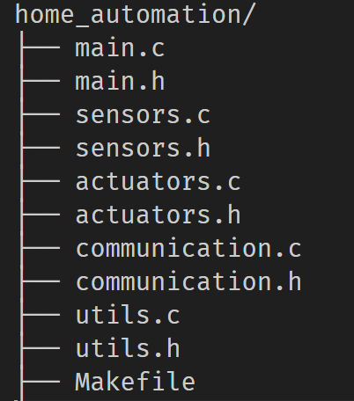
Software Development: File structure
C source + Headers
Makefile for compilation
Multiple files for separation of concerns

Slide 5
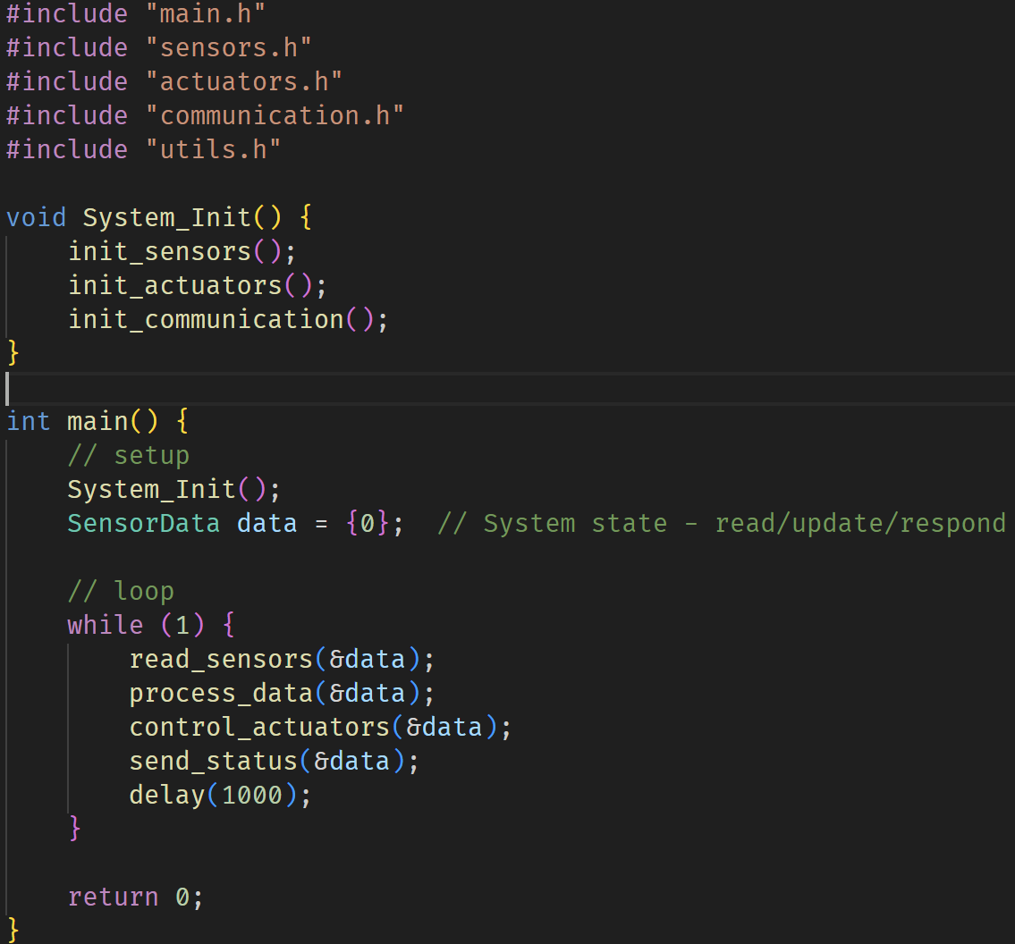
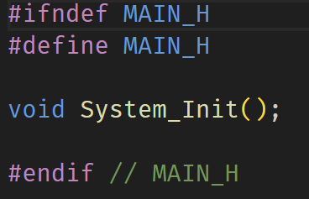
Header - prototypes, data types
main() structure:
setup
loop
Modular - functions

Slide 6
Why Architecture
Careful up-front design and planning
Constructing a large project
Readability and Maintainability of code
Highly desirable:
Modular code
Low coupling - separation of concerns
Cohesion
Configurability

Slide 7
Software Engineering
Design
Documentation
Version control
Testing
Integration and Deployment
Common design patterns, experience-based suggestions

Slide 8
Design Patterns

Slide 9
What?
Distilled experience
Best practices, Coding style, Naming conventions…
Patterns are more specific to the system architecture
Suggested ways of solving certain problems

Slide 10
State Machines
System State: “memory” - what is the system currently doing
Evolution of states: how to respond to inputs
Outputs: dependent on states
Example:
LED with single button control:
1 press - turn on LED
1 more - start blinking
after 5 blinks, or if 1 more press, stop blinking
Digital clocks, kitchen appliances,
Limited controllability scenarios

Slide 11
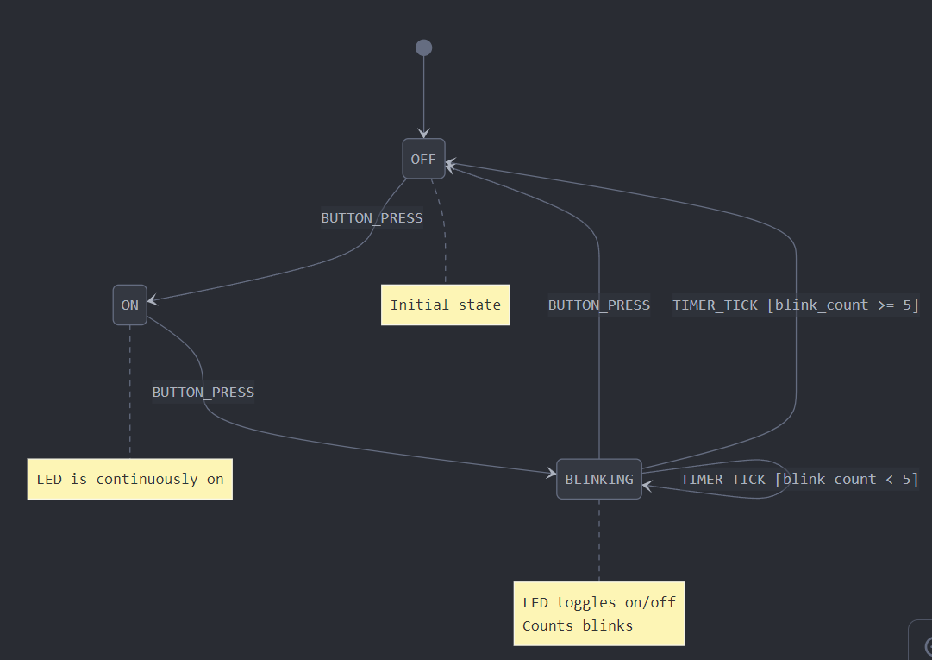

Slide 12
Concepts
States: Represent the different modes or conditions the system can be in.
Events: Triggers that can cause state transitions.
Transitions: Define how the system moves from one state to another in response to events.
Actions: Operations performed when entering a state, exiting a state, or during a transition.

Slide 13
Benefits
Predictability: Clearly defines system behavior for each state.
Maintainability: Easier to modify or extend system behavior.
Debugging: Simplifies tracking system behavior and identifying issues.
Resource Efficiency: Can be implemented with minimal memory overhead.

Slide 14
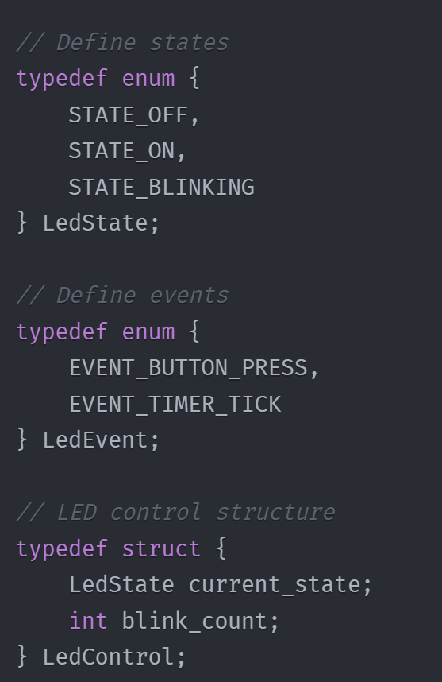
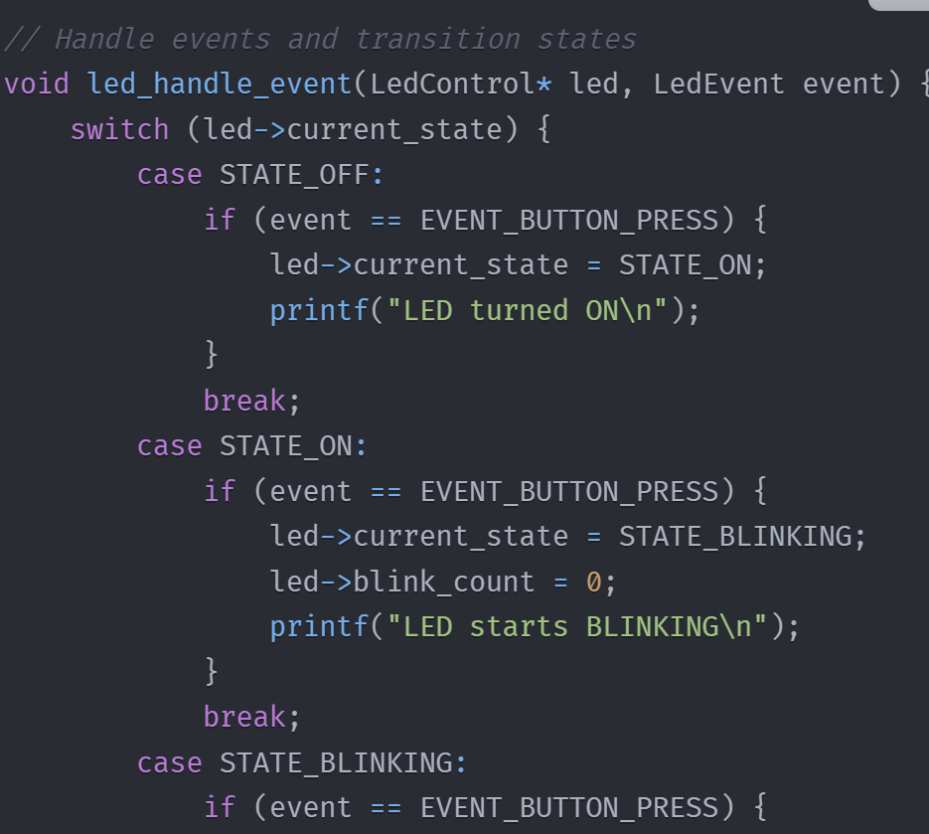

Slide 15
Coding Styles
Switch-Case Implementation: Simple but can become unwieldy for complex state machines.
Table-Driven Approach: More flexible and easier to maintain for larger state machines.
Object-Oriented Approach: Each state is represented by a separate class (less common in embedded C, more in C++).

Slide 16
Challenges
Complexity: State machines can become complex with many states and transitions.
Timing: Ensuring proper timing for state transitions in real-time systems.
Testing: Comprehensive testing needed to cover all possible state transitions - possibilities for exponential increase

Slide 17
Observer Pattern
One-to-many dependencies
Example:
Motion sensor
Notify:
alarm system to check for intruder
cat feeding system for pets
garage opener
Not all may respond - but all may need to be notified

Slide 18
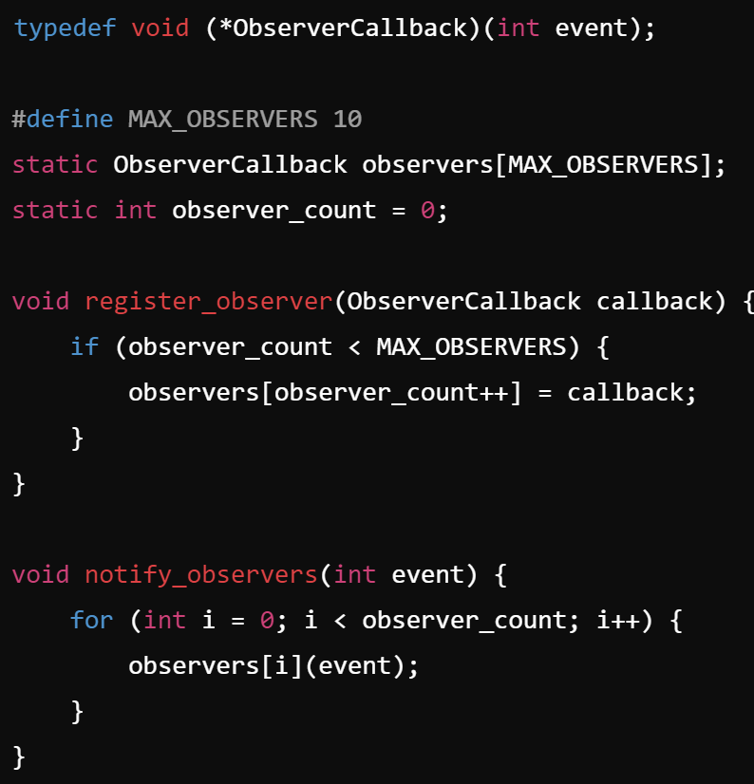
Callback functions
Registering observer callbacks
Notifications

Slide 19
Examples
Sensor data: log and display
Button press: single button can trigger multiple changes in different parts of system
Network state change: when WiFi available: activate downloads, check for updates, move apps to foreground etc.

Slide 20
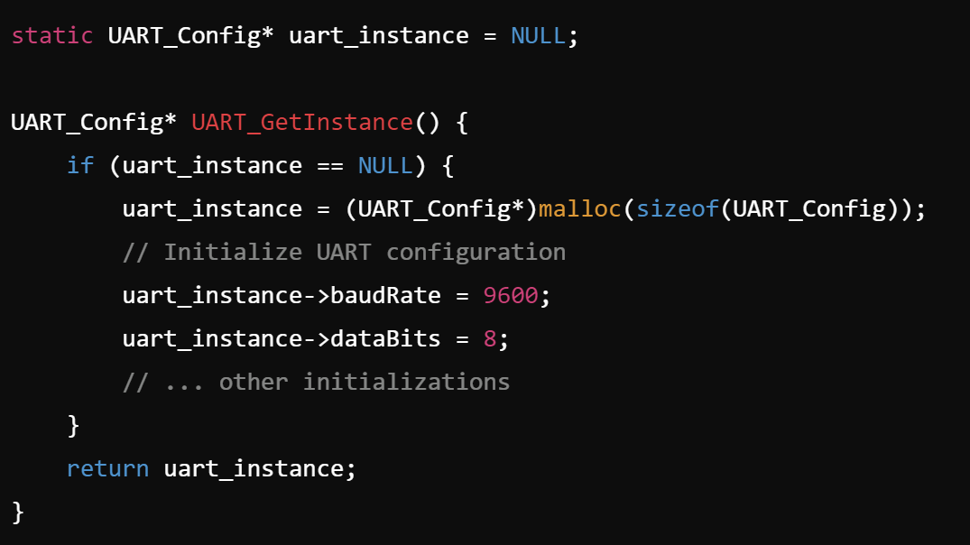
Singleton Pattern
Globally unique / single resource
Controlled access
“static” or “global” code

Slide 21
Other Design Patterns
Command Pattern: encapsulate request as object, allow queuing, logging
Factory Method: Common interface for instantiating
Object oriented
Very powerful abstractions possible for elegant code
Strategy Pattern: choose among multiple possible strategies
simple linear control
PID control
fuzzy logic, neural network based control
… decide at run-time
… Many more patterns: studied in software engineering practice

Slide 22
Architecture Patterns

Slide 23
Layered Architecture
Hardware
Drivers / Operating System
Middleware - helper functions
Software / Application
Many variants with different layering possible
Not restricted to embedded systems

Slide 24
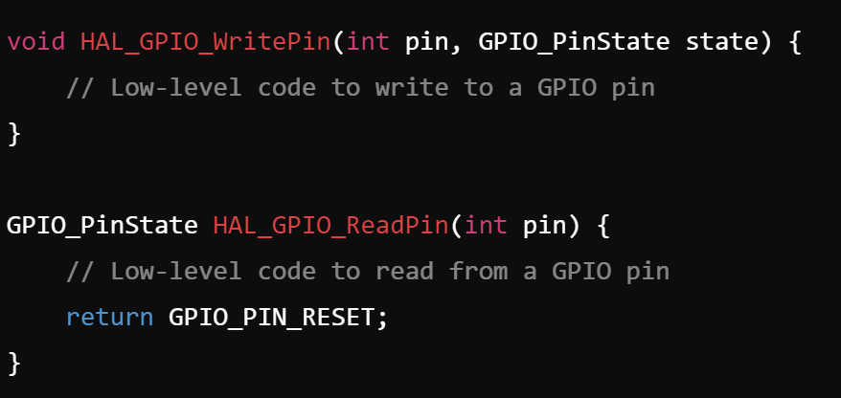
Hardware Abstraction Layer

Slide 25
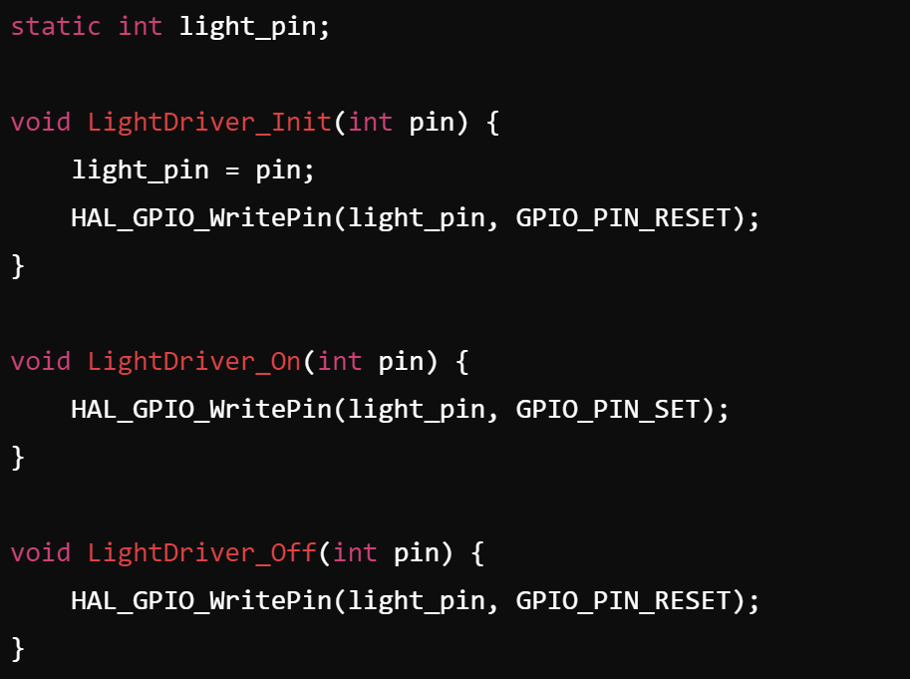
Driver Layer
Build on HAL functions to control interaction with specific devices

Slide 26
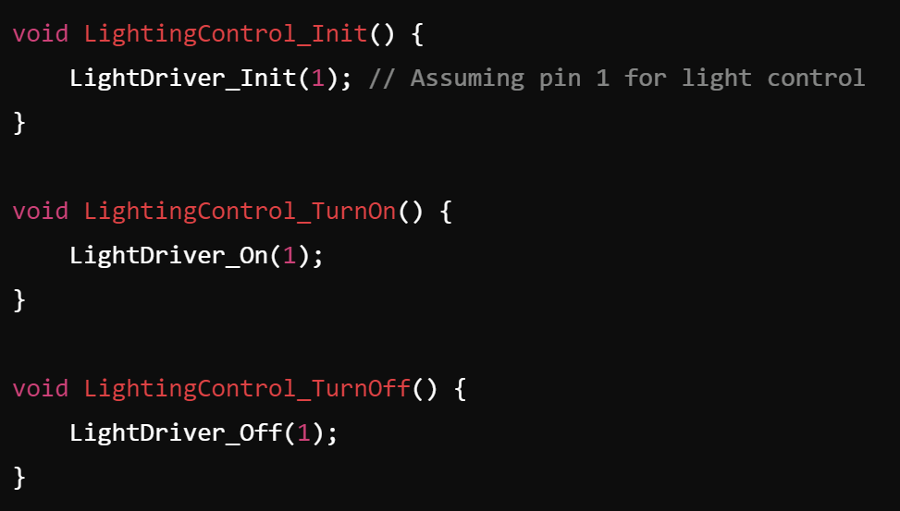
Middleware Layer
Build on drivers to provide functionality

Slide 27
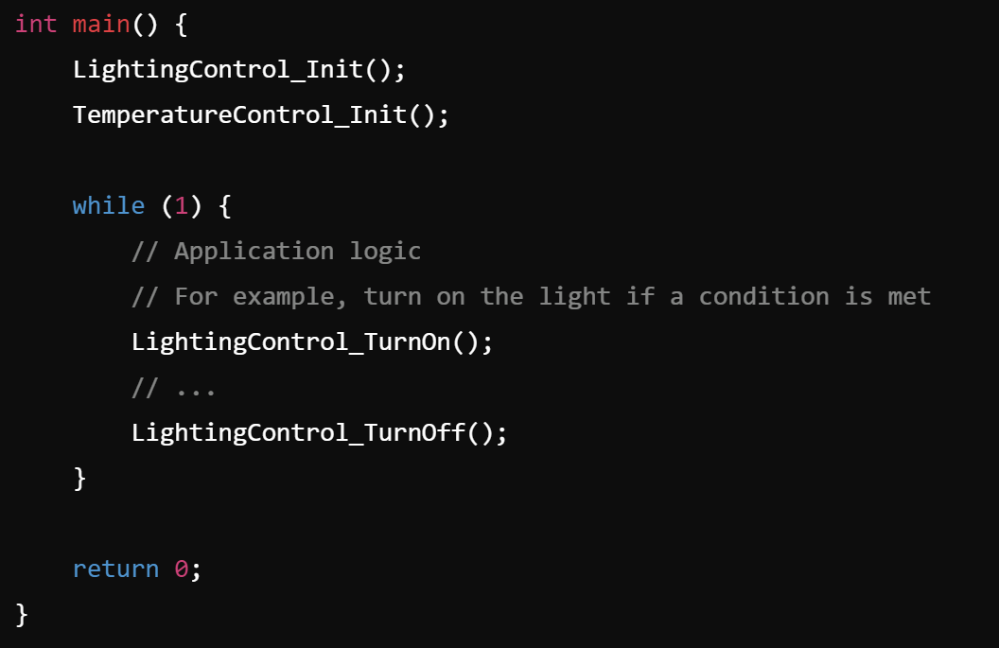
Application Layer
Build on functions to create application logic

Slide 28
Benefits
Modularity: Each layer has a specific responsibility, making the system easier to understand and maintain.
Reusability: Components in the HAL and middleware layers can be reused across different projects.
Scalability: New features can be added by extending the appropriate layer without affecting others.
Testability: Each layer can be tested independently, improving the overall test coverage and reliability of the system.

Slide 29
Event-driven architecture
Loosely coupled systems:
each entity works independently
reacts to input conditions
produces events to control
Events
Pressing a button
Temperature crossing a threshold
Motion sensor detection

Slide 30
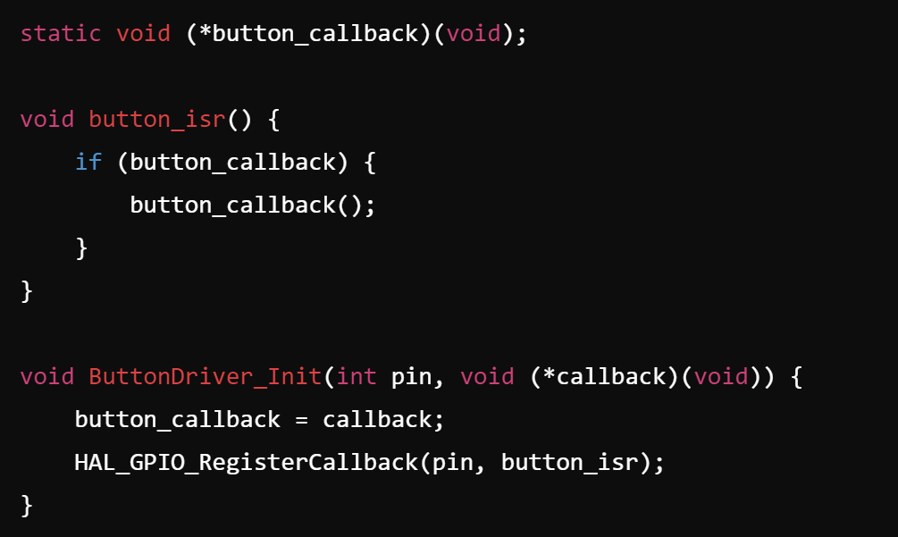
Callbacks and ISRs
Interrupts - ideal way to deliver “event notification”
Interrupt Service Routine (ISR) - respond
Callback - programming pattern

Slide 31
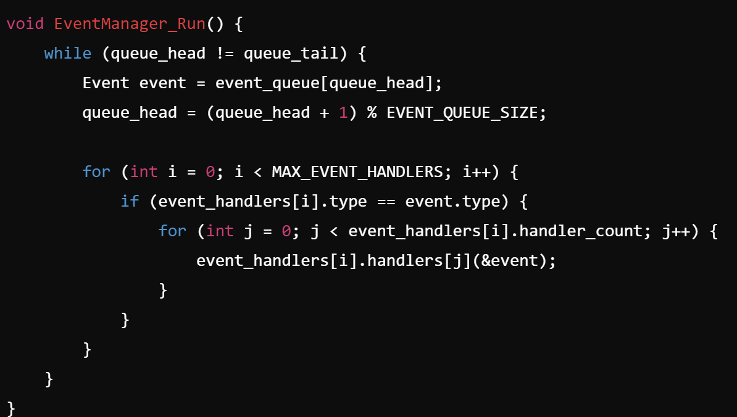
Typical Event Manager

Slide 32
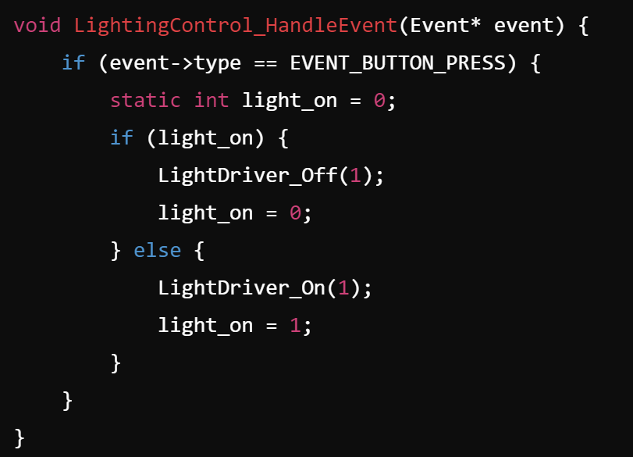
Event Handler

Slide 33
Event-driven Architecture
Advantages
Highly responsive to external inputs
Efficient for systems with unpredictable inputs
Facilitates loose coupling between components
Disadvantages
Can be complex to debug due to non-linear execution flow
May lead to callback hell if not carefully designed

Slide 34
Microkernel Architecture
More complex systems:
File interaction
Network
Multiple peripherals and drivers
Monolithic kernel:
single operating system kernel with all drivers and functionality
Microkernel
Minimal resource management
Inter-process communication
Task scheduling
Operating system

Slide 35
Other Architectural Patterns
Message passing
Component based
Client-Server
Distributed
Pipelined
…
Not mutually exclusive: considerable overlap (HAL, drivers, interrupts etc.)
Do not get bogged down in pigeon-holing

Slide 36
Scenario 1: Smart Home Security System
A company is developing a new smart home security system with the following requirements:
Multiple sensors (door/window sensors, motion detectors, cameras) throughout the house
Central control panel with a touchscreen interface
Mobile app for remote monitoring and control
Integration with smart home devices (lights, thermostats)
Real-time alerts and notifications
Video recording and playback functionality
Regular software updates and easy addition of new features

Slide 37
Scenario 1: Smart Home Security System
A company is developing a new smart home security system with the following requirements:
Multiple sensors (door/window sensors, motion detectors, cameras) throughout the house
Central control panel with a touchscreen interface
Mobile app for remote monitoring and control
Integration with smart home devices (lights, thermostats)
Real-time alerts and notifications
Video recording and playback functionality
Regular software updates and easy addition of new features
Observations:
unpredictable inputs (sensor activations, user interactions)
real-time response needed
multiple asynchronous events
should be highly responsive
add new functionality
Loose coupling is evident
Event-driven may be most suitable

Slide 38
Scenario 2: Medical Infusion Pump
A medical device company is designing a new infusion pump for hospital use. The requirements include:
Precise control of fluid delivery rates
Multiple therapy modes (continuous, intermittent, patient-controlled)
Comprehensive alarm system for various fault conditions
User interface for nurses and doctors to program and monitor the device
Logging system for all actions and events
Integration with hospital information systems
Ability to update software and add new therapy modes
Strict safety and reliability requirements

Slide 39
Scenario 2: Medical Infusion Pump
A medical device company is designing a new infusion pump for hospital use. The requirements include:
Precise control of fluid delivery rates
Multiple therapy modes (continuous, intermittent, patient-controlled)
Comprehensive alarm system for various fault conditions
User interface for nurses and doctors to program and monitor the device
Logging system for all actions and events
Integration with hospital information systems
Ability to update software and add new therapy modes
Strict safety and reliability requirements
Observations:
Safety and reliability - isolation of critical components.
requires modularity
Strict separation between core functions (drug delivery) and additional services (user interface, logging, network communication) is beneficial for safety certification
Microkernels provide isolation and ability to add features

Slide 40
Error Handling

Slide 41
Errors
What?
Any kind of “wrong” behaviour - unexpected, undefined, …
So?
Embedded software - long running operations - recovery challenges
Safety critical applications
Resource constraints - cannot waste on wrong behaviour
Error handling
Graceful recovery
User experience
Debugging and maintenance

Slide 42
Types of errors
Compile time
Syntax, type mismatches: caught early - always preferable
Embedded systems have long run time - better to catch problems at compile time
Interpreted vs Compiled languages - compile time checks
Run-time
Memory: buffer overflows, null pointers
Potential to remain hidden for long periods of time
Logical
Program logic errors - functionality
Mostly evident unless rare cases

Slide 43
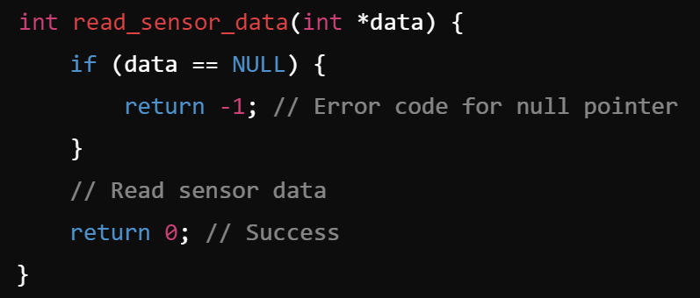
Error handling: return codes
Modular programming:
function calls
return types
Check error on function return
Propagate up through stack
Simple
low overhead
Can be ignored
Clutter

Slide 44
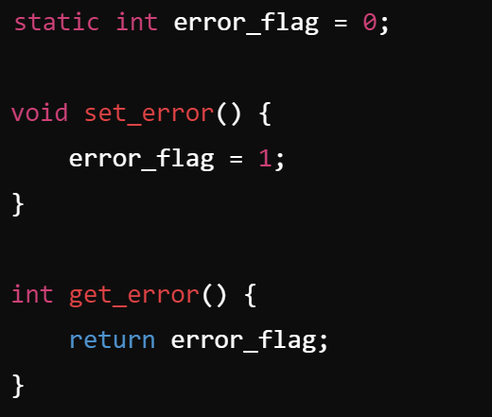
Error handling: Flags
Global or static variables
Indicate error states - accessible to all functions
Easy to check anywhere in code
Globals
Race conditions

Slide 45
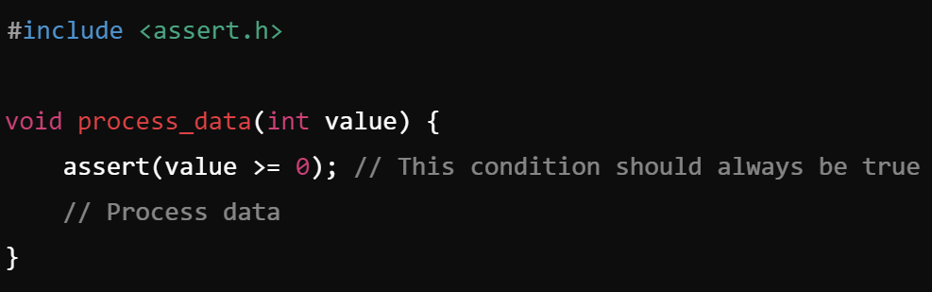
Error handling: Assertions
Conditions that should always be true - else run-time error
Can catch errors early
Less useful in production code

Slide 46
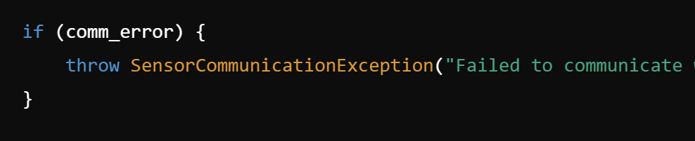
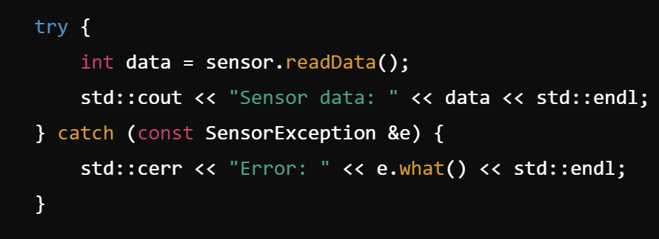
Error handling: Exceptions
More abstract way to indicate error - propagate and handle in complex ways
Separate error handling from normal control
More complex
Not always available - may need C++

Slide 47
Error handling: Other techniques
Watchdog timers
Failsafe modes
Redundancy
Error correcting codes (for data/communication errors)
Self-tests and diagnostics (early detection rather than handling)
. . .

Slide 48
Strategies
Error classification
Recoverable / Non-recoverable
System-level / Module level
Reporting mechanism
Logging
Communication (if available)
Status lights (LEDs)
Recovery mechanism
Report and proceed
Graceful degradation (fail-safe)
Reset - partial or full system

Slide 49
Debugging
(High level - not detailed techniques)

Slide 50
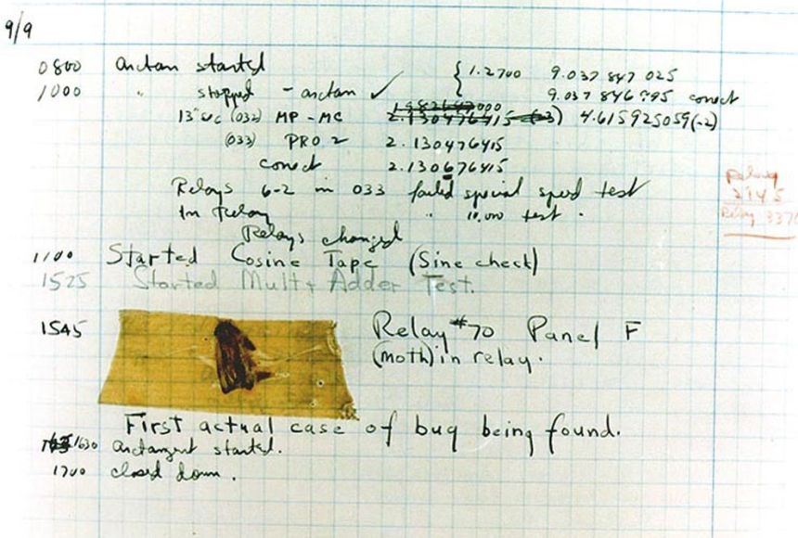
PHOTOGRAPH COURTESY NAVAL SURFACE WARFARE CENTER, DAHLGREN, VIRGINIA, via National Geographic Education

Slide 51
Bugs in Embedded Systems
Any bug is bad news (or at least not good news)
Embedded systems
Limited visibility into system state
Limited logging and monitoring
Real-time nature - transient bugs?
Hardware-software interaction issues

Slide 52
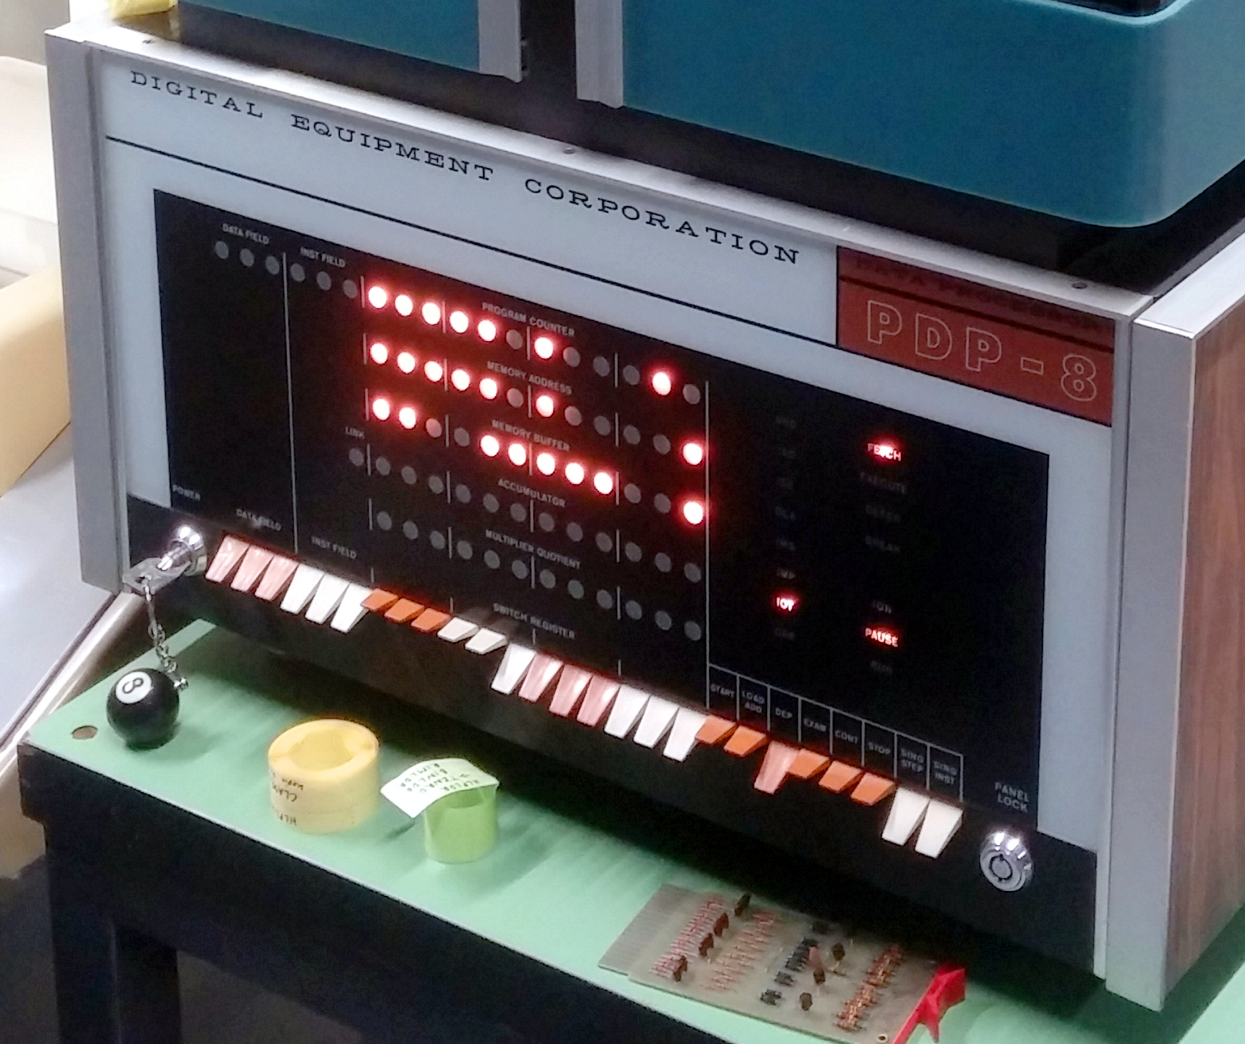
Debugging: LEDs
Simplest status indicator: GPIO sufficient
Power on
Programming complete
Mode of operation
…
Very limited expressivity
By Morn, Wolfgang Stief (https://www.flickr.com/photos/stiefkind/16736865797/)

Slide 53
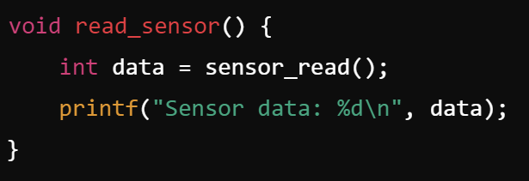
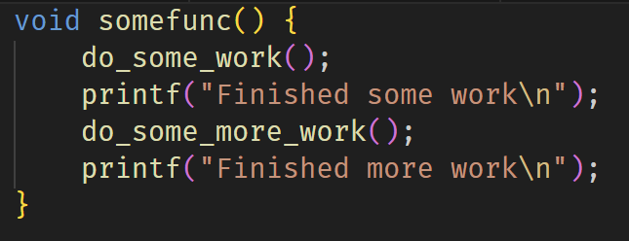
Debugging: “printf”
Brute force but simple…
Requires communication channel
Can affect timing! (Heisenbugs!)

Slide 54
More debugging approaches
Simulators:
System simulation often cheaper than real hardware
Much better visibility, tracing of signals
Cannot model asynchronous interactions easily or accurately - Heisenbugs hard to find…
Debuggers:
Hardware-in-the-loop
Single-stepping, catch and model exceptions
Trace buffers, Logic Analyzers, …
Complex but important part of system design

